Slide 1
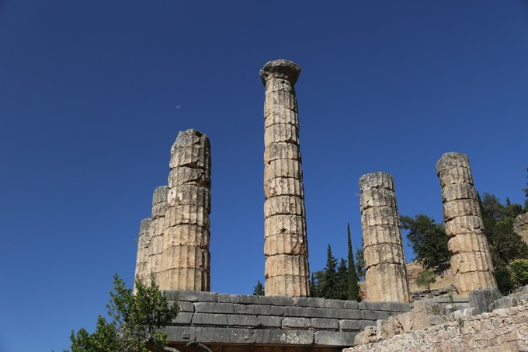
人工智能 Artificial Intelligence (AI) 2023-2024
know yourself

Slide 2
About Course
Staff
刘峡壁：中心教学楼901室，电话：68913500，
E-mail: liuxiabi@bit.edu.cn
Reference books
刘峡壁等. 人工智能：机器学习与神经网络. 北京：北京理工大学出版社，2023.01
Course website
http://www.knowyourself.xyz/AI/

Slide 3
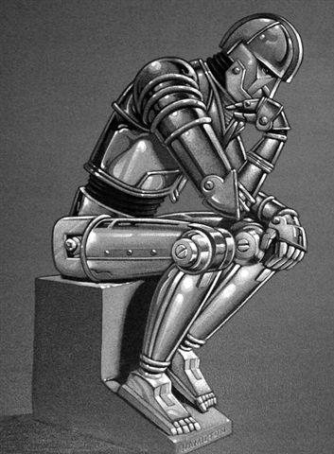
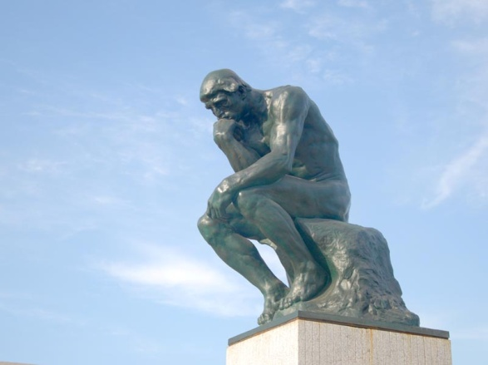
AI is always developing
Artificial Intelligence
Intelligence

Slide 4
AI is always developing
2023：ChatGPT
2016：AlphaGo
2006：深度学习
1997：深蓝
1985：BP算法
1956：人工智能学科
1969：《感知器》
哲学、逻辑学、数学、心理学、神经科学、计算机 …………

Slide 5
PartⅠ: Philosophy in AI

Slide 6
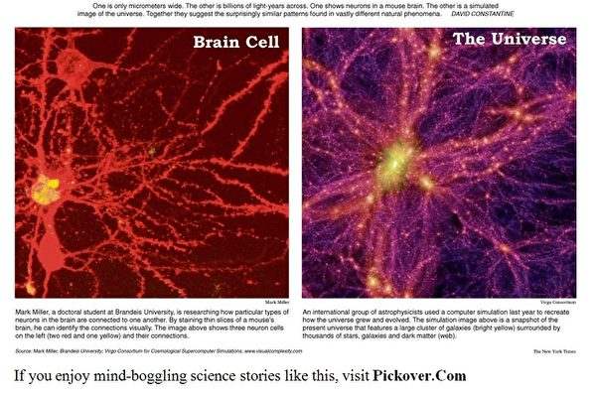
What is Intelligence, anyway??
R. J. Sternberg: “Viewed narrowly, there seem to be almost as many definitions of intelligence as there were experts asked to define it.”
It is useful to think of intelligence in terms of an open collection of attributes.

Slide 7
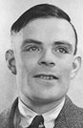
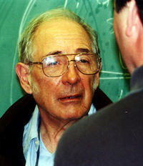
How to measure Machine Intelligence?
Two views
Behavior/action (weak AI )
Can the machine act intelligently?
Turing test.
Thought process/reasoning (strong AI )
Are machines actually thinking?
Chinese Room of J. R. Searle

Slide 8
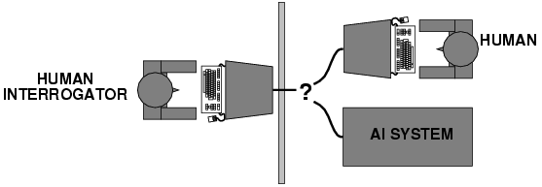
Turing test
When does a system behave intelligently?
A. M. Turing (1950) Computing Machinery and Intelligence. Mind 49: 433-460.
Operational test of intelligence: imitation game
Requires the collaboration of major components of AI: knowledge, reasoning, language understanding, learning, …

Slide 9
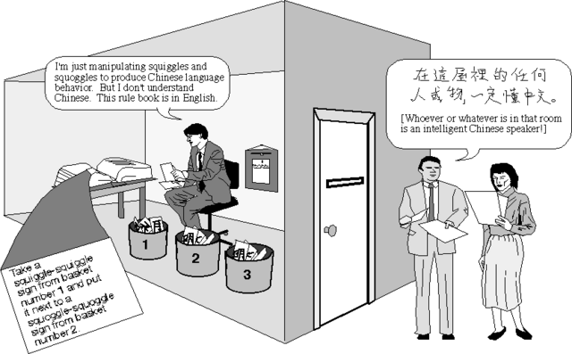
Chinese Room Argument
A man is in a room with a book of rules. Chinese sentences are passed under the door to him. The man looks up in his book of rules how to process the sentences. Eventually the rules tell him to copy some Chinese characters onto paper and pass the resulting Chinese sentences as a reply to the message he has received. The dialog continues. To follow these rules the man need not understand Chinese.
Searle, John. R. (1980) Minds, brains, and programs. Behavioral and Brain Sciences 3 (3): 417-457
Therefore, Searle says (1980):
- the idea of a non-biological machine being intelligent is incoherent

Slide 10
Goals of AI
Current goal
- Making intelligent machines, especially intelligent computer programs.
- Design and construction of useful new tools to extend human intellectual and creative capabilities
Long-term goal
Understanding of the mechanisms underlying thought and intelligent behaviors and their embodiment in machines

Slide 11
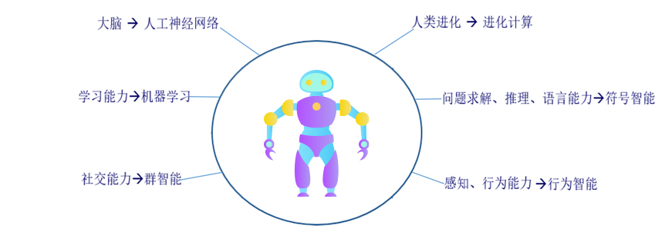
What is AI, anyway??
Copy our intelligent capabilities

Slide 12
Part Ⅱ: Approaches to AI

Slide 13
Approaches to AI
Symbolic AI
Machine Learning
Nouvelle AI
Computational Swarm Intelligence
Connectionism
Evolutionary Computation

Slide 14
1. Symbolic AI
Physical Symbol System Hypothesis of Newell and Simon
- the processing of structures of symbols by a digital computer is sufficient to produce artificial intelligence
- the processing of structures of symbols by the human brain is the basis of human intelligence
- it remains an open question whether the Physical Symbol System Hypothesis is true or false
- Top-down strategy

Slide 15

Symbolic AI
Problem-sloving → Expert System → Knowledge Engineering
- Search, Representation, Reasoning
- GPS, Deep Blue, DENDRAL, CYC…..
Notes:
GPS: 西蒙的通用问题求解
DENDRAL：第一个专家系统
Go: 围棋

Slide 16
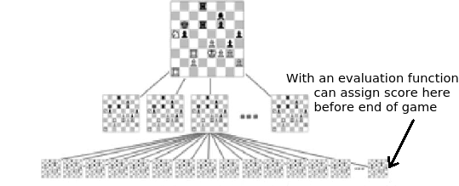
Search Problem
How to search is a key to Symbolic AI as well as AI
Notes:
GPS: 西蒙的通用问题求解
DENDRAL：第一个专家系统
Go: 围棋

Slide 17
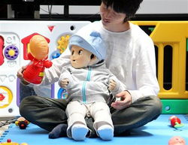
2. Learning Approach
John McCarthy:
Q. What about making a ``child machine'' that could improve by reading and by learning from experience?
A. This idea has been proposed many times, starting in the 1940s. Eventually, it will be made to work. However, AI programs haven't yet reached the level of being able to learn much of what a child learns from physical experience. Nor do present programs understand language well enough to learn much by reading.

Slide 18
Tasks of Machine Learning
Learning means change
Improve behaviour/performance:
• learn to perform new tasks (more)
• increase ability on existing tasks (better)
• increase speed on existing tasks (faster)
Produce and increase knowledge:
• formulate explicit concept descriptions
• formulate explicit rules
• discover regularities in data
• discover the way the world behaves

Slide 19
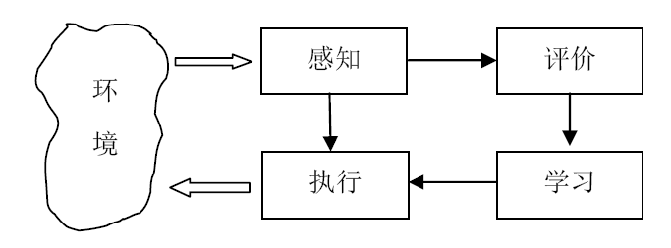
The Architecture of intelligent system with learning capability
Envionment
Perception
Evaluation
Performance
Learning

Slide 20
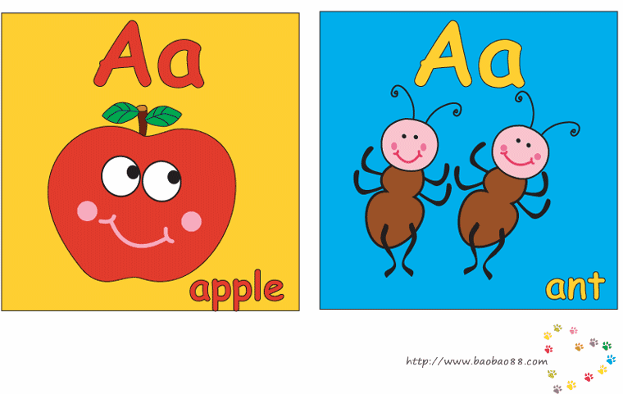
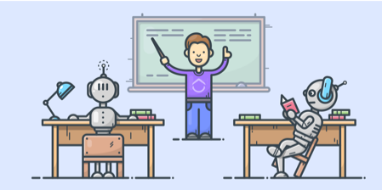
Kinds of Learning
Supervised Learning
Given a set of example input/output pairs, find a rule that does a good job or predicting the output associated with a new input.
Training data, Validation data, Test data

Slide 21

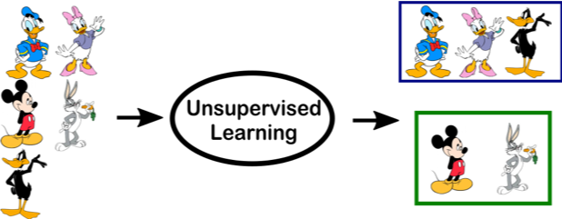

Kinds of Learning
Unsupervised Learning
Given a set of examples, no labeling of them, find distributions or rules from them
clustering
Associate Rule Mining

Slide 22
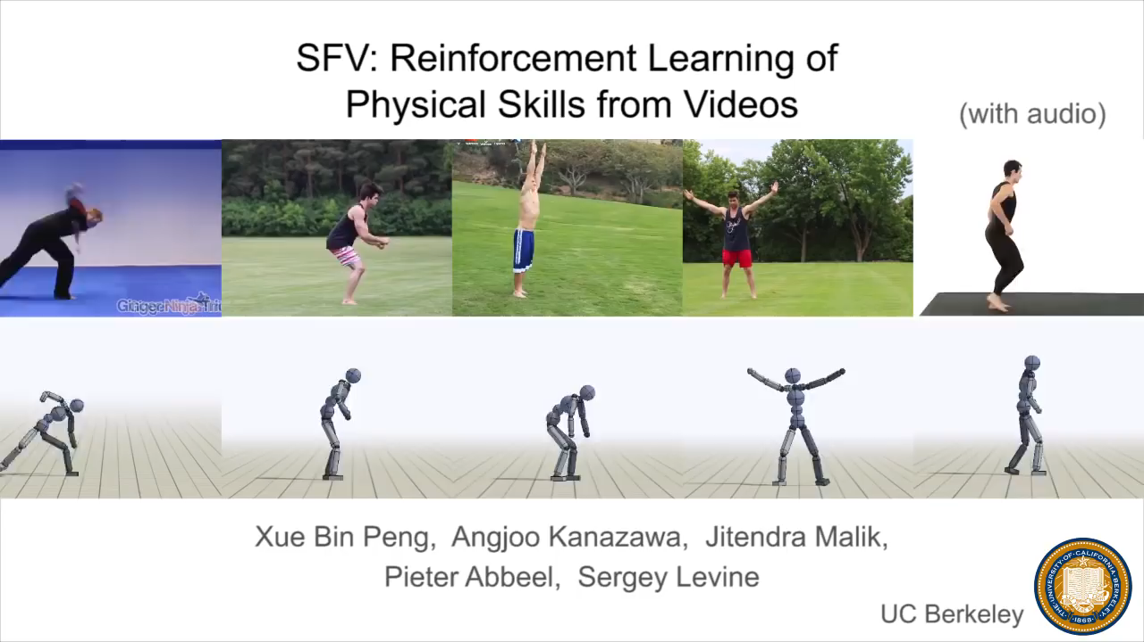
Kinds of Learning contd.
Reinforcement Learning
An agent interacting with the world makes observation, takes actions, and is rewarded or punished; it should to learn to choose actions in such a way as to obtain a lot of reward.

Slide 23
3. Nouvelle AI
Rodney Brooks (1991)
<<Intelligence without Representation>>
Insect-like mobile robots: Allen, Herbert, Genghis
- The basic building blocks of intelligence are very simple behaviours, More complex behaviours "emerge" from the interaction of these simple behaviours.
- Producing systems that display approximately the same level of intelligence as insects.

Slide 24
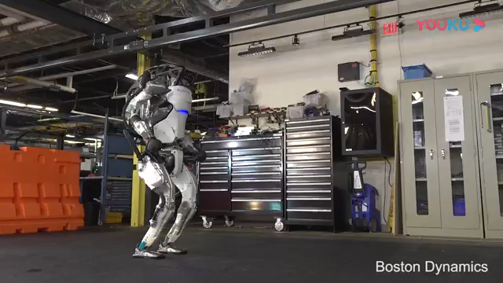
Example of Nouvelle AI

Slide 25
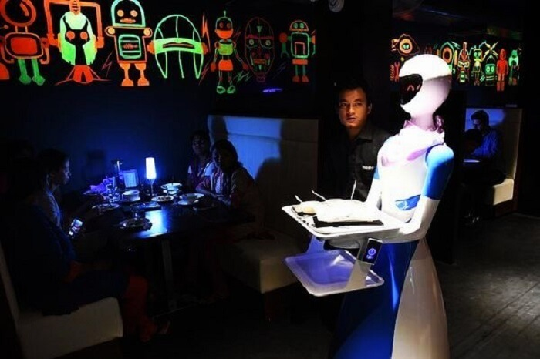
Nouvelle AI
Situated AI
- Build disembodied intelligences who unfriendly interact with the world (traditional)
- Build embodied intelligences situated in a real world (Nouvelle).
Lifetime Learning
- Reinforcement learning
- Adapt to environment by acting and receiving reward/punishment in the environment.

Slide 26
4. Computational Swarm Intelligence
Intelligence is often considered a property of individuals.
Are we social because we are intelligent or are we intelligent because we are social?
- Intelligence can emerge from social interaction.
Emergent behaviour – when a group behaves in ways that were not ”programmed” into its members.
Swarm intelligence
- simulated social interaction
- emergent collective intelligence of groups of simple agents

Slide 27
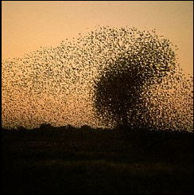
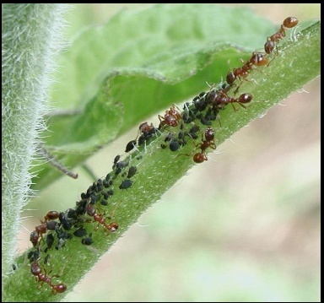

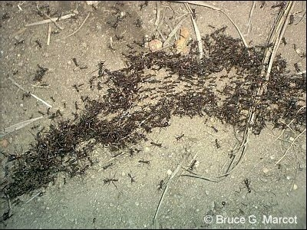
Computational Beauty in Nature

Slide 28
Observations
Bird flocks and fish schools move in a coordinated way, but there is no coordinator (leader)
- So, what decides the behaviour of a leader-less flock?
Ants and termites quickly find the shortest path between the nest and a food source
- ... and solve many other advanced problems as well: keeping cattle, building (ventilated) housing, coordinated heavy transports, tactical warfare, cleaning house, etc.
- A single ant is essentially a blind, memory-less, random walker!
Distributed systems without central control
Useful not only to simulate but also to solve optimization problems

Slide 29
Computational Simulation
Multi-Agent Systems
- a system composed of multiple interacting intelligent agents.
- application including computer games, networks, transportation, logistics, and etc.
Swarm Optimization
- Ant Colony Optimization
- Particle Swarm Optimization

Slide 30
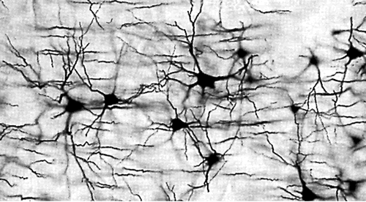
5. Connectionism
The mechanisms of brains are very different in detail from those in computers
how brains work? → Bottom-up strategy
Natural Neural Network

Slide 31
Connectionism
A brief history
M-P neuron (McCulloch & Pitts) → Perceptron (Rosenblatt) → Hopfield Model, B-P Learning Method (Rumelhart & McClelland) → Deep Learning (Geoffrey Hinton)
Applications
Recognition, Vision, Business, Medical, …….
Core Issues
- Topology
- Learning Methods

Slide 32
Artificial Brain
Artificial brains are a man-made machines that have the same cognitive ability as humans and other mammals.
There are two broad approaches to achieving this goal:
Conducting large-scale, biologically-realistic, human brain simulations within currently available supercomputers
The building of novel, massively-parallel, neuromorphic computing devices that are closely modeled on neural tissue

Slide 33
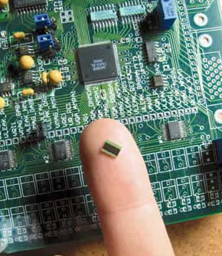
Neuromorphic chip from Stanford
This tiny chip—packaged in black plastic and mounted on a printed circuit board—models 1,024 excitatory pyramidal cells and 256 inhibitory basket cells. Their cellular properties and synaptic organization are downloaded to the chip over a USB link, which also allows their activity to be visualized in real-time.
https://web.stanford.edu/group/brainsinsilicon/index.html

Slide 34
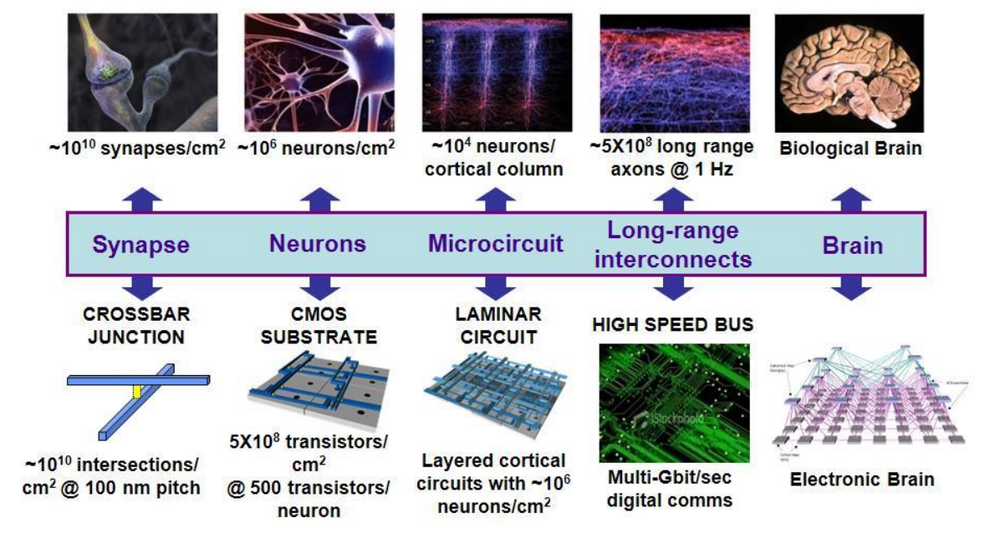
Neuromorphic Computing

Slide 35
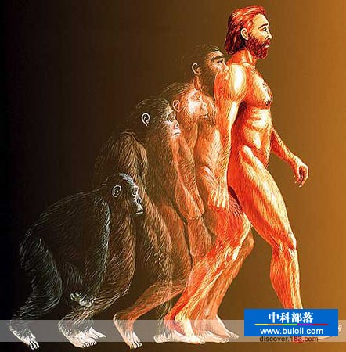
6. Evolutionary Computation
Biological evolution
To produce an enormous variety of living organisms closely suited to different sets of needs in different environments.
Simulated evolution
By modeling those processes of biological evolution on computers, it turns out that we can sometimes get the computers to evolve solutions to problems.

Slide 36
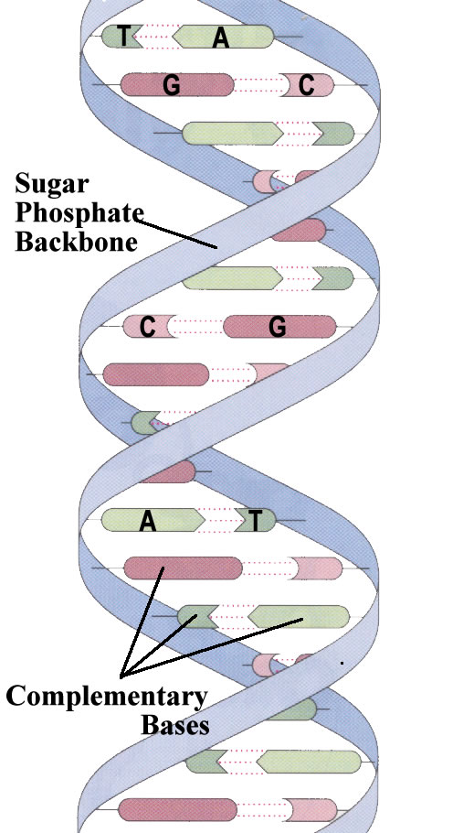
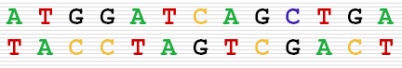
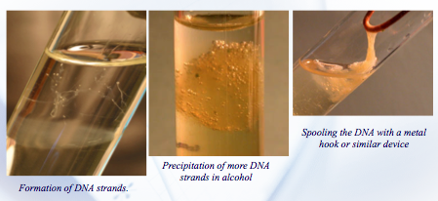
DNA Computing

Slide 37
Evolutionary Computation
Genetic Algorithm
Use strings of symbols to encode solutions to problems, like strings of molecules in DNA. Transforming and recombining portions of strings enables an evolutionary computation to search for good solutions, partly analogous to biological evolution.
Genetic Programming
Extends these ideas to automatic programming by using structures which are better suited to the problem than strings are.

Slide 38
Evolutionary Computation
Evolutionary Strategy
Use natural problem-dependent representations, and primarily mutation and selection as search operators. Mutation is normally performed by adding a normally distributed random value to each vector component. The step size or mutation strength is often governed by self-adaptation. The selection in evolution strategies is deterministic and only based on the fitness rankings, not on the actual fitness values.
Evolutionary Programming
Harder to distinguish from evolutionary strategies. Its main variation operator is mutation; members of the population are viewed as part of a specific species rather than members of the same species therefore each parent generates an offspring.

Slide 39
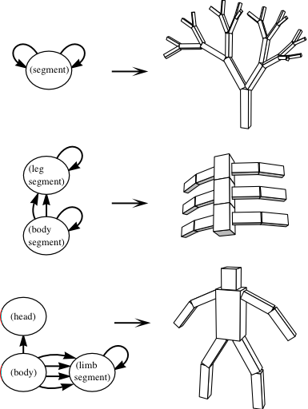
Example: Forming body plans with evolution
Node specifies part type, joint, and range of movement
Edges specify the joints between parts
Population?
Graphs of nodes and edges
Selection?
Ability to perform some task (walking, jumping, etc.)
Mutation?
Node types change/new nodes grafted on
From Virgil Griffith, Google Tech Talk - 2007
Notes:
Though not explicitly about AI, this is an example of using evolution to create body plans to solve particular tasks -- a decidedly nontrivial problem.

Slide 40
Artificial Life (Alife)
Artificial Life is the study of man-made systems that exhibit behaviors characteristic of natural living systems. It complements the traditional biological sciences concerned with the analysis of living organisms by attempting to synthesize life-like behaviors within computers and other artificial media. By extending the empirical foundation upon which biology is based beyond the carbon-chain life that has evolved on Earth, Artificial Life can contribute to theoretical biology by locating life-as-we-know-it within the larger picture of life-as-it-could-be."
Chris Langton (in Proc. of first Alife conference)

Slide 41
Artificial Life and Evolutionary
Life,
as it is…
and might have been
Origin of Life
From Virgil Griffith, Google Tech Talk - 2007
Today

Slide 42

线上学习
学习内容：六大技术途径的原理与方法
网址：人工智能 - 北京理工大学 - 学堂在线 (xuetangx.com)
成绩评定：在线练习与考试，占比30%

Slide 43
课堂学习
学习内容：六大技术途径的部分前沿研究
结构学习、注意力、可解释性
元学习、小样本学习
知识与学习的结合
成绩评定：平时每讲总结占比20%，大作业占比50%
加 分 项：上台总结5分、大作业上台讲演10分

Slide 44
End of Lecture1
LIUXIABI@BIT.EDU.CN

